Slide 1
Statistics and Reliability: Module 2
Basic Statistics
Notes:
Module Topics
Drawing valid statistical conclusions
Central limit theorem and sampling distribution of the mean
Basic probability concepts
Types of data and measurement scales
Data collection methods
Techniques for assuring data accuracy and integrity
Descriptive statistics
Probability distributions
Copyright (c) Deere & Company, as an unpublished work. This material is the property of Deere & Company. All use, disclosure, and/or reproduction not specifically authorized by Deere & Company is prohibited.

Slide 2
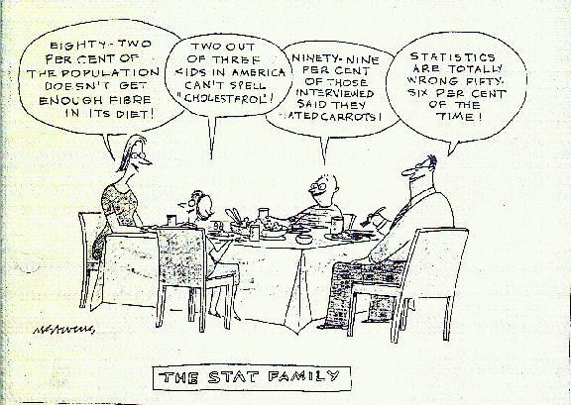
Notes:
“63% of all statistics are made up.” – Bill Randall, JDPS

Slide 3
Population and Sample
Population
Population
Sample
Sample
Population
Sample
Notes:
Population is the entire area of interest.
Sample is a subset of the population.
The key question to ask is: “How representative is this sample?”
When dealing with any data set, always ask, “What is the population and what is the sample?”
And the more of the population we sample, the less uncertainty we have in the results; or, conversely and more commonly, the less we sample of the population, the more uncertainty we have in the results.

Slide 4

Notes:
Anyone remember this (from your history class – not personally)?

Slide 5
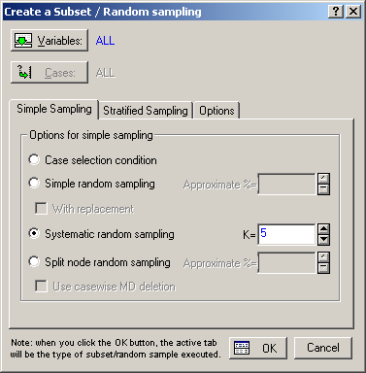
Notes:
Random Subset
There are all kinds of sampling approaches, for example:
Simple random sampling
Systematic random sampling
Split node random sampling
Stratified sampling
The key factor is defining the “frame” – the characteristic that defines the population. In the Dewey Defeats Truman scenario, the frame was the phone book, and in those days mainly wealthy Republicans had phones, so they were over represented in the sample.

Slide 6
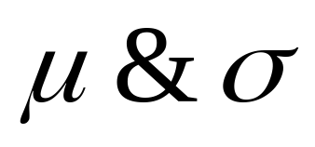
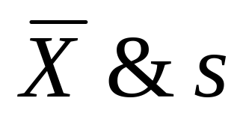
Population and Sample
Population
Sample
How representative is this sample?
Notes:
Like professionals in many other fields, statisticians like to call the same things by different names and different things by the same name (how many definitions are there for “force” or “power” or “is”?).
μ = Population Mean Parameter
σ = Population Standard Deviation Parameter
X-bar = Sample Mean Statistic
s = Sample Standard Deviation Statistic
Population: “It’s all Greek to me”

Slide 7


Example
Sample = 1000
Population = 280 million
Sample
Population
Notes:
Sampling happens every day.
If you are a couch potato, your whole life is affected by Nielsen ratings, which are determined by a sample of TV viewers.
Statistical inference allows us to make statements about the population using the sample data.

Slide 8
Enumerative vs. Analytic Studies
Enumerative
Analytic
Sample (?)
Sample
Now
Population
Population
Now
Future
Notes:
“Enumerative Studies answer questions about populations that consist of a finite set of identifiable units. In the product reliability context, these units may be in service in the field or they may be stored in boxes in a warehouse. Typically, the statistical study is conducted by selecting a random sample from the population, carefully evaluating the units in the sample, and then making an inference about the population at large.”
“Analytic Studies answer questions about processes that generate units or other output over time. Again, in the reliability context, interest might center on the life distribution of electric motors that will be produced, in the future, by a particular production process.”
[Meeker and Escobar, Statistical Methods for Reliability Data, p. 16]
Most reliability studies are Analytic, and a lot can change from the time the study was conducted to the time the population exists.
As Deming points out, it is possible, in an enumerative problem, to reduce errors of sampling to any specified level. In contrast, in an analytic problem, it is impossible to compute the risk of making a wrong decision. This is one reason why control charts are preferred for analytic studies, instead of hypothesis testing.

Slide 9
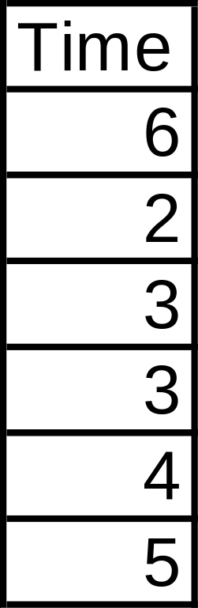
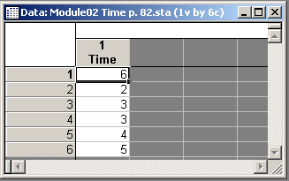
Sample Data
Notes:
Data from “3.8 Sample Statistics (Mean, Range, Standard Deviation, and Median)” (p. 81-84)

Slide 10
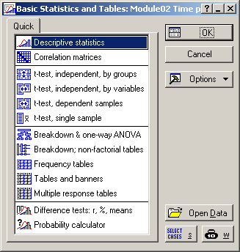
Notes:
Descriptive Statistics
First select Basic Statistics/Tables from the Statistics menu and use the Descriptive statistics option.

Slide 11
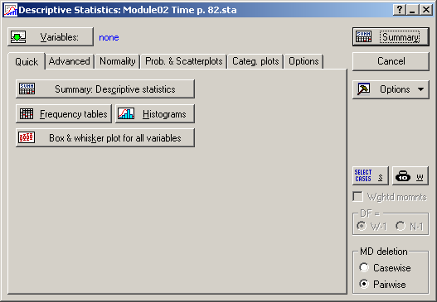
Notes:
Descriptive Statistics: Quick Tab
Click the “Variables” button and select the variable Time. Then click the “Summary: Descriptive statistics” button

Slide 12

Default = N, Mean, Min, Max, Std. Dev.
Notes:
Mean = 3.83 (page 82)
Standard Deviation = 1.472 (page 83)

Slide 13
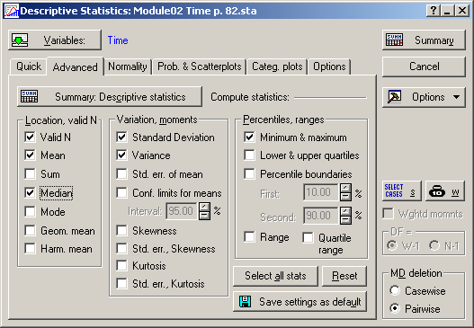
Notes:
Descriptive Statistics: Advanced Tab
Select “Median” and “Variance” and click “Summary: Descriptive statistics” or just “Summary”

Slide 14

Notes:
Variance = 2.167 (page 83)
Median = 3.5 (page 84)

Slide 15
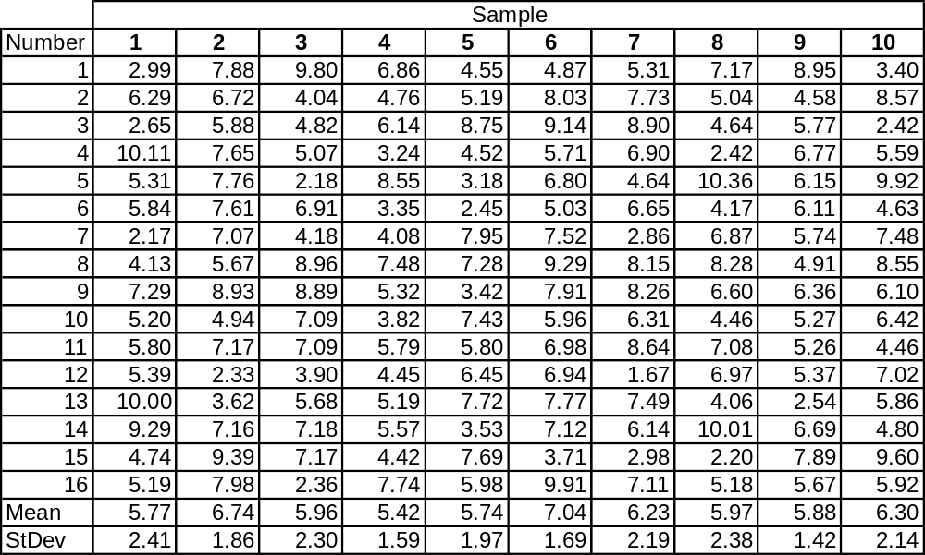
Table 3.3 Ten Random Samplings from a Normal PDF Where μ = 6 and σ = 2
Notes:
Here’s a much bigger data set. There are two ways of analyzing it in Statistica.

Slide 16
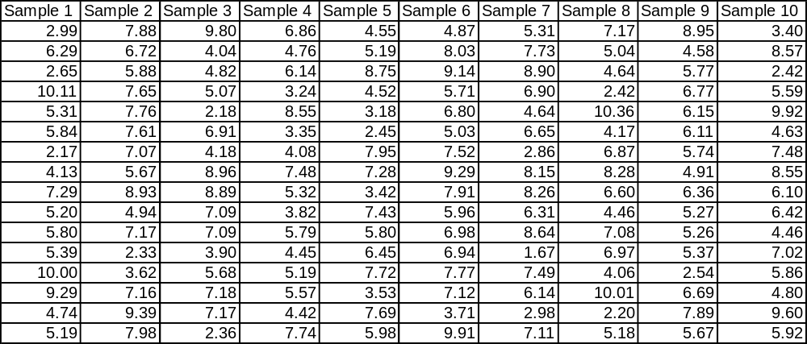
Data in Statistica Format - Method 1
Notes:
The first method is to keep the data in its original format. That is, one column for each sample.

Slide 17

Notes:
First select Basic Statistics/Tables from the Statistics menu and use the Descriptive statistics option.

Slide 18
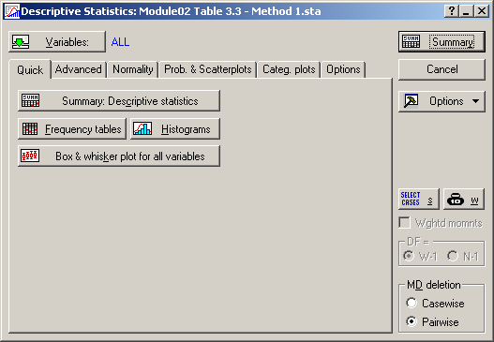
Notes:
Select ALL variables (Sample 1, Sample 2 ... Sample 10)

Slide 19
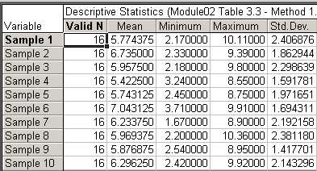
Notes:
By default, the sub-sample size, mean, minimum, maximum and standard deviation are calculated for each sample.

Slide 20
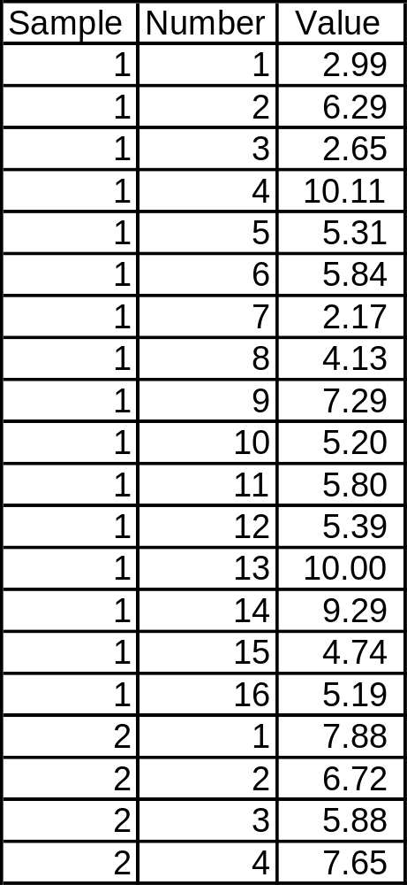
Data in Statistica Format - Method # 2
Only the first 20 of 160 values are shown
Notes:
The second method requires reformatting the data so that on column identifies the sample and another contains the value of the measurements. A third column is shown to identify where the data came from for traceability, but it is not used in the analysis.

Slide 21
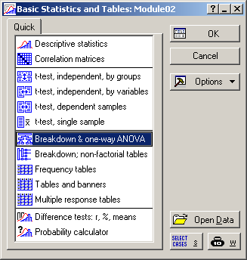
Notes:
First select Basic Statistics/Tables from the Statistics menu and use the Breakdown & one-way ANOVA option.

Slide 22
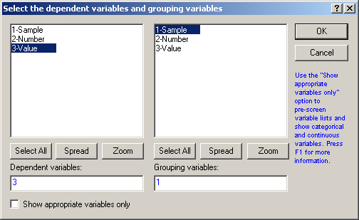
Notes:
Now you need to specify two variables:
Dependent variable = the measurement values
Grouping variable = the sample ID

Slide 23
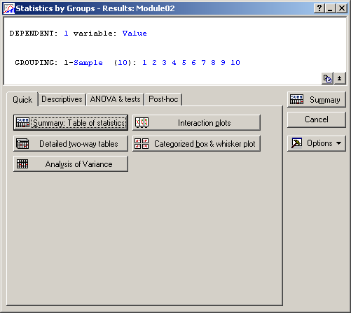
Notes:
Click “Summary: Table of statistics”

Slide 24
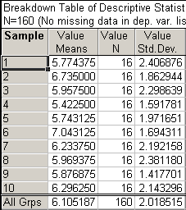
Notes:
By default, the sub-sample size, mean, and standard deviation are calculated for each sample.

Slide 25
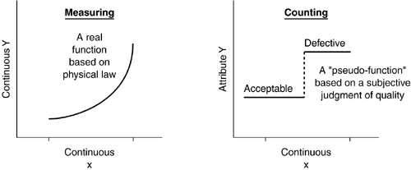
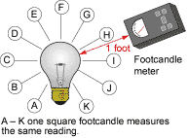
Variable versus Attribute Data
Variable Data
Attribute Data
On
Off
Notes:
Variable data is often described as quantitative data. It is information rich. That is, you learn a lot from relatively few samples of the population, say 30. Unfortunately, this type of data often requires expensive gages to obtain measurements and time to take the measurements.
Attribute data is often described a qualitative data. It is information poor. That is, you need a very large number of samples of the population, say more than 100, to learn anything. This type of data is common because the measurements are cheap and fast to obtain.
The challenge is to change from attribute data measurements to variable data measurements. This is often a Measure problem is Six Sigma.

Slide 26
Levels of Measurement
Nominal: Nominal data have no order and thus only gives names or labels to various categories
Ordinal: Ordinal data have order, but the interval between measurements is not meaningful.
Interval: Interval data have meaningful intervals between measurements, but there is no true starting point (zero)
Ratio: Ratio data have the highest level of measurement. Ratios between measurements as well as intervals are meaningful because there is a starting point (zero)
Notes:
“The experimental (scientific) method depends on physically measuring things. The concept of measurement has been developed in conjunction with the concepts of numbers and units of measurement. Statisticians categorize measurements according to levels. Each level corresponds to how this measurement can be treated mathematically. Nominal comes from the Latin root nomen meaning name. Nomenclature, nominative, and nominee are related words. Gender is nominal. (Gender is something you are born with, whereas sex is something you should get a license for.)”
“Example 1 – Colors: To most people, the colors: black, brown, red, orange, yellow, green, blue, violet, gray, and white are just names of colors. To an electronics student familiar with color-coded resistors, this data is in ascending order and thus represents at least ordinal data. To a physicist, the colors: red, orange, yellow, green, blue, and violet correspond to specific wavelengths of light and would be an example of ratio data.”
“Example 2 – Temperatures: What level of measurement a temperature is depends on which temperature scale is used. Specific values: 0°C = 32°F = 273.15 K = 491.69°R, 100°C = 212°F = 373.15 K = 671.67°R, -17.8°C = 0°F = 255.4 K = 459.67°R where C refers to Celsius (or Centigrade before 1948); F refers to Fahrenheit; K refers to Kelvin; R refers to Rankine. Only Kelvin and Rankine have zeroes (starting point) and ratios can be found. Celsius and Fahrenheit are interval data; certainly order is important and intervals are meaningful. However, a 180° dashboard is not twice as hot as the 90° outside temperature (Fahrenheit assumed)! Rankine has the same size degree as Fahrenheit but is rarely used.”
“Although ordinal data should not be used for calculations, it is not uncommon to find averages formed from data collected which represented Strongly Disagree, ..., Strongly Agree! Also, averages of nominal data (zip codes, social security numbers) are rather meaningless!”
http://www.andrews.edu/~calkins/math/webtexts/stat01.htm#LEVELS

Slide 27
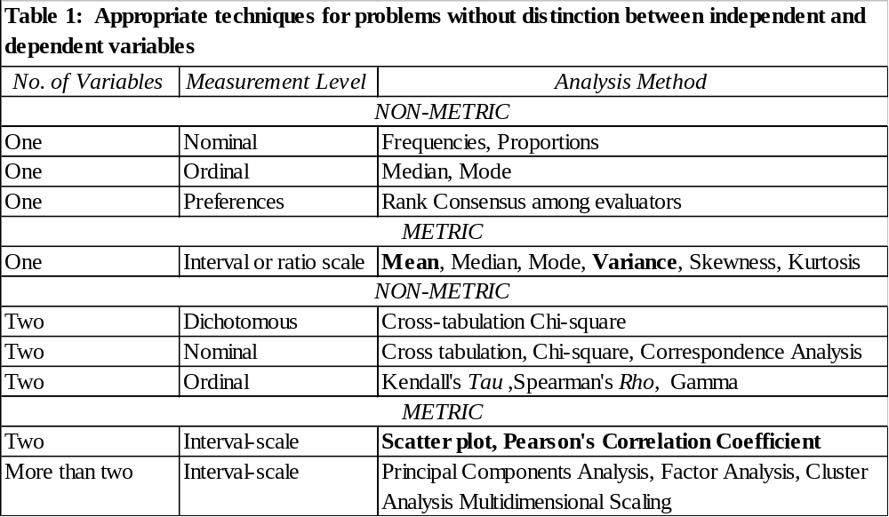
Notes:
Choice of Statistical Techniques
“As mentioned earlier, the choice of a statistical technique is a complex issue, which should not be reduced to a cookbook approach. With this caveat, we have suggested appropriate techniques for different data analysis situations in Tables 1 and 2. They are meant to be a framework, and are intended as general guidelines. They should not be applied rigidly in all situations. It would be desirable to try more than one way of analyzing the data, whenever possible.”
http://www.unesco.org/webworld/idams/advguide/Chapt1_5.htm

Slide 28
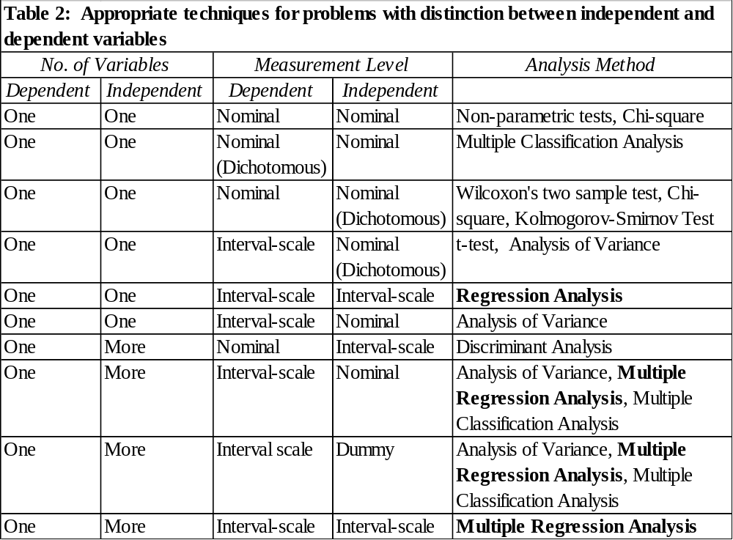
Notes:
Note that I have bolded a few techniques. These are one that we will be working with later. You should be aware of the types of data you should analyze with these techniques as well as the types of data you should not analyze. If you have the other types of data, try the other techniques.

Slide 29
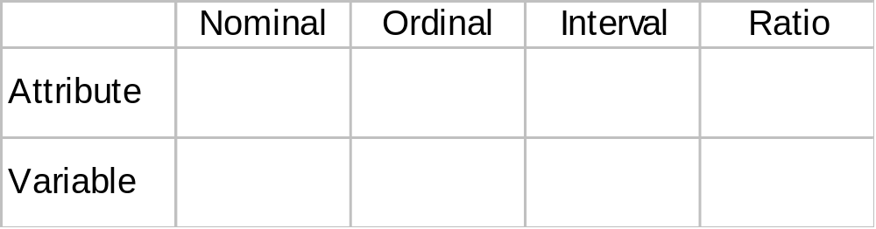
Pop Quiz
Classify the following: cause, part number, number of claims, machine use periods (MUPS), Failure Per Machine (FPM), Cost Per Machine (CPM)
Notes:
Attribute data: Any data measurements that are not quantified on an infinitely divisible numeric scale. Includes items like counts, proportions, ratios, or percentage of a characteristics, (i.e. sex, loan forms, department attendance, etc.) that have measurements like pass or fail, leak or no leak, small, medium, or large, go or no go tests. Can also be and is referred to as attribute data. The opposite of variable data. Variable data type have real numbers in the measurement like 2.34, 2.55, etc. (i.e. data that can be measured on a continuous scale)
http://www.sixsigmaspc.com/dictionary/discreteattributedata.html
Variable data: Any data measurements that are quantified on an infinitely divisible numeric scale. Includes items like lengths, diameters, temperatures, electrical measurements, or hours, (i.e. blue print specifications, electrical specifications, etc.) that have measurements like 2.34, 2.55, etc. The opposite of Discrete or Attribute data. These data types measure items like pass or fail, leak or no leak, small, medium, or large, go or no go tests.
http://www.sixsigmaspc.com/dictionary/variabledata.html
Attribute Data: Attribute data is the lowest level of data. It is purely binary in nature. Good or Bad, Yes or No. No analysis can be performed on attribute data. Attribute data must be converted to a form of Variable data, called discrete data, in order to be counted or useful. It is commonly misnamed discrete data.
http://www.isixsigma.com/dictionary/Attribute_Data-95.htm

Slide 30
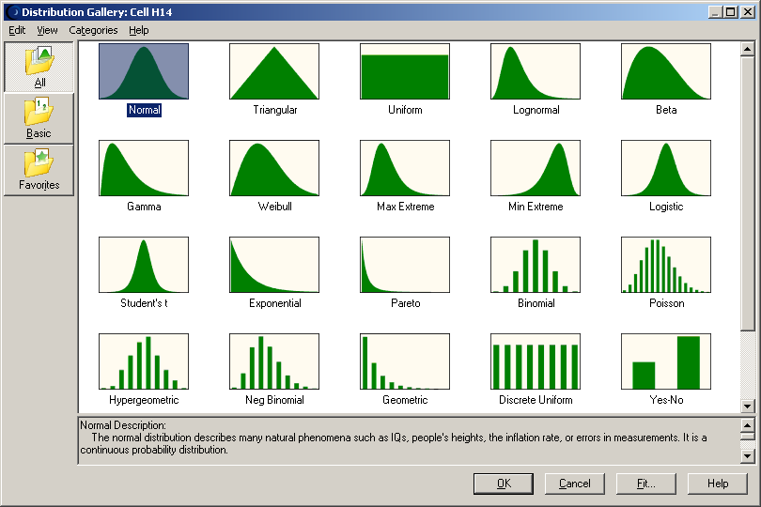
Notes:
There are many distributions that are useful for modeling data. Above are the ones available in Crystal Ball. We will only cover the most popular: Normal, Binomial and Poisson.
Note: the continuous distributions, often used for Variables data, are represented with solid Probability Density Functions (PDFs); and the discrete distributions, often used for Attribute data, are represented with vertical bars.

Slide 31
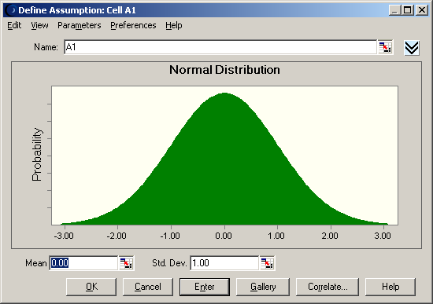
Notes:
Normal Description:
The normal distribution describes many natural phenomena such as IQs, people's heights, the inflation rate, or errors in measurements. It is a continuous probability distribution.
The parameters for the normal distribution are mean and standard deviation.
There are three conditions underlying the normal distribution:
1) Some value of the unknown variable is the most likely (the mean of the distribution).
2) The unknown variable could as likely be above or below the mean (symmetrical about the mean).
3) The unknown variable is more likely to be close to the mean than far away. Of the values of a normal distribution, approximately 68% are within one standard deviation of the mean.

Slide 32
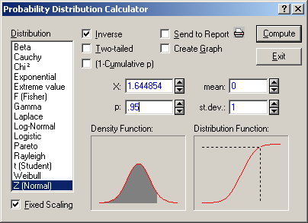
Notes:
In Statistica, use the Probability Distribution Calculator at the bottom of the Statistics Menu.
Compare to Figure 7.1 Normal PDF and Figure 7.2 Normal CDF.

Slide 33
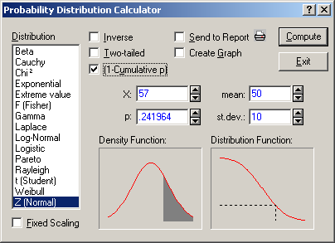

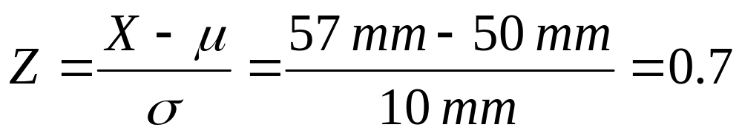
Z-Transform
P(X > 57 mm)
P(Z > 0.7)
Notes:
Compare to 7.3 Example 7.1 Normal Distributions
The Z-Transform transforms any Normal distribution to a Standard Normal Distribution, that is, one with mean 0 and standard deviation of 1.

Slide 34
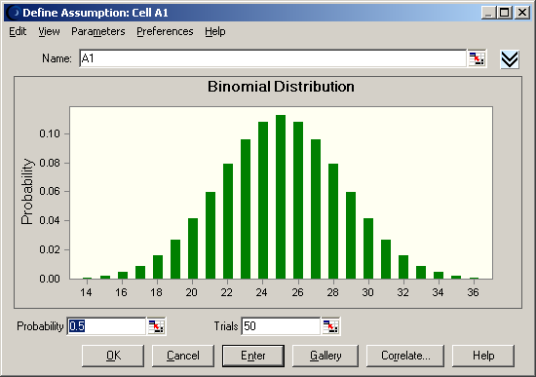
Notes:
Binomial Description:
The binomial distribution describes the number of successes in a fixed number of trials, such as the number of heads in 10 flips of a coin or the number of defective parts among 50 items. It is a discrete probability distribution.
The parameters for the binomial distribution are probability and trials.
There are three conditions underlying the binomial distribution:
1) For each trial, there are two possible outcomes, success or failure.
2) The trials are independent. What happens in the first trial does not affect the second trial, and so on.
3) The probability of success remains the same from trial to trial

Slide 35
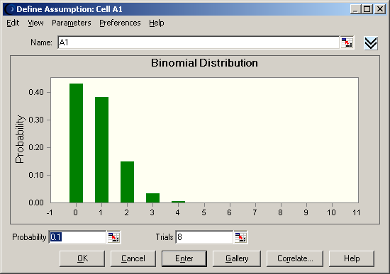
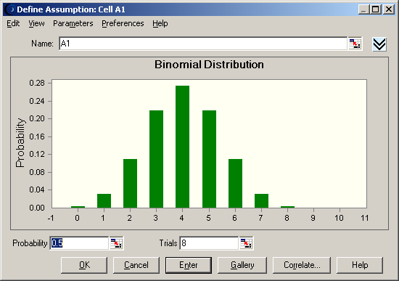
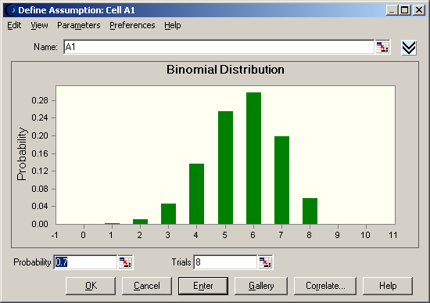
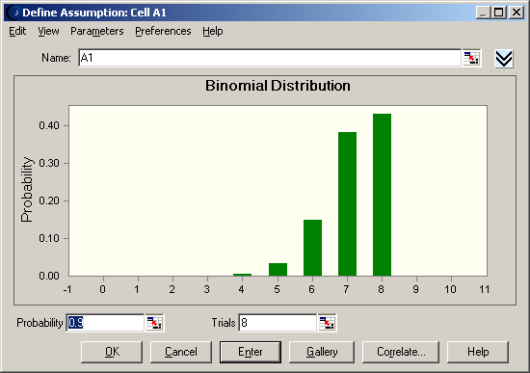
Notes:
Compare to Figure 7.4 Binomial PDF

Slide 36
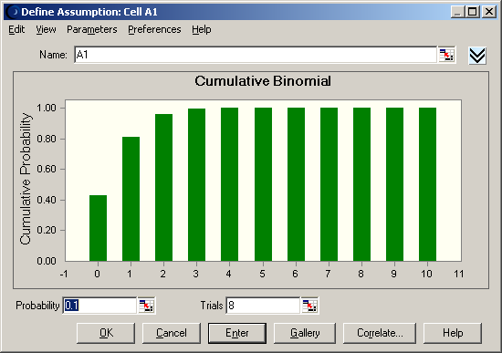
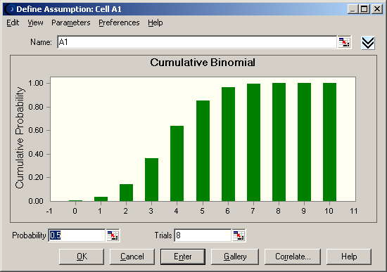
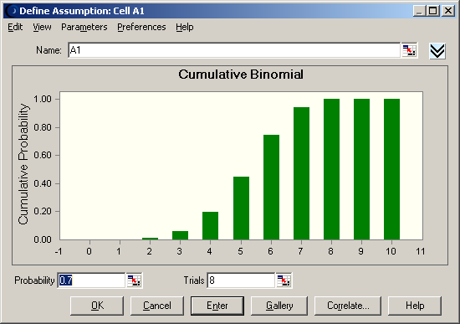
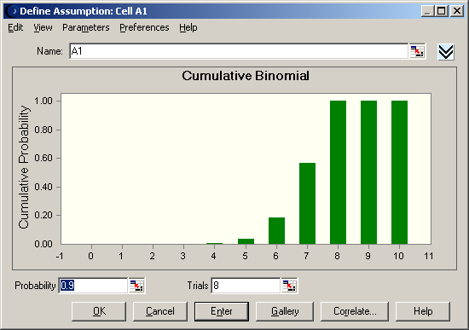
Notes:
Compare to Figure 7.5 Binomial CDF

Slide 37
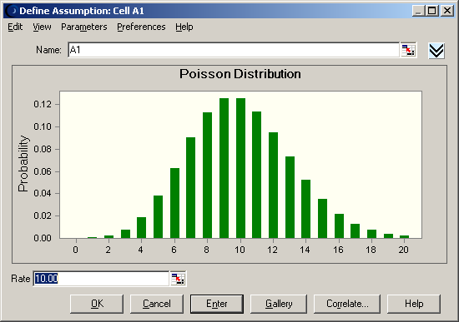
Notes:
Poisson Description:
The Poisson distribution describes the number of times an event occurs in a given interval, such as the number of telephone calls per minute or the number of errors per page in a document. It is a discrete probability distribution.
The parameter for the Poisson distribution is rate.
There are three conditions underlying the Poisson distribution:
1) The number of possible occurrences in any unit of measurement is not limited to a fixed number.
2) The occurrences are independent. The number of occurrences in one unit of measurement does not affect the number of occurrences in other units.
3) The average number of occurrences must remain the same from unit to unit.

Slide 38
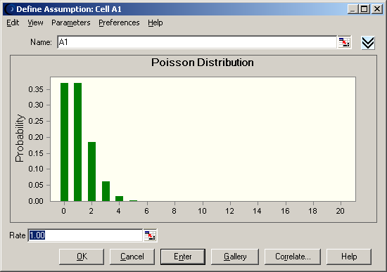
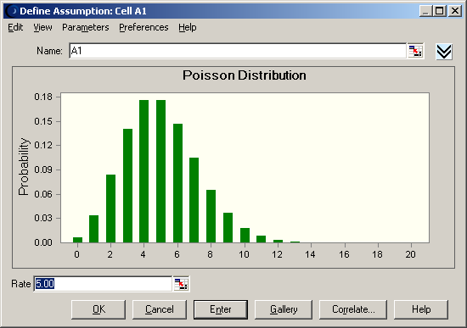
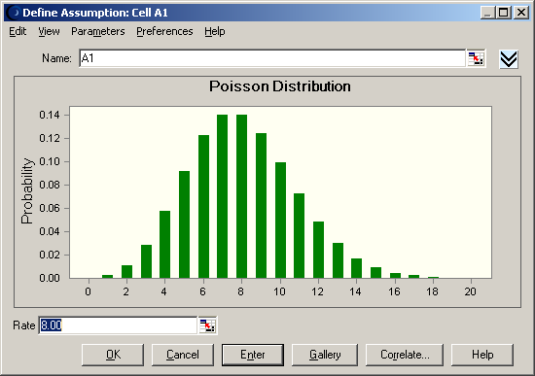
Notes:
Compare to Figure 7.6 Poisson PDF

Slide 39
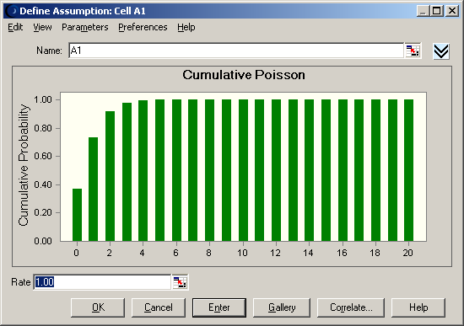
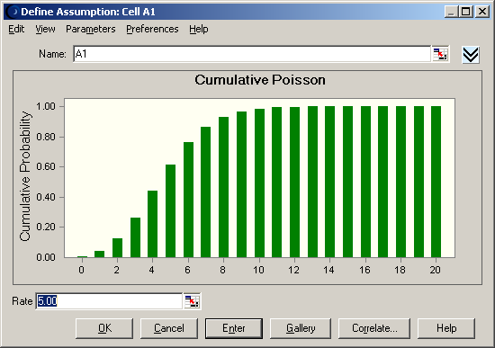
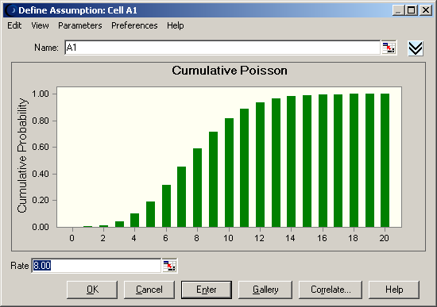
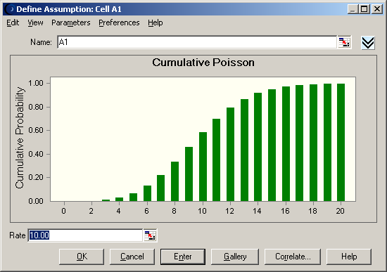
Notes:
Compare to Figure 7.7 Poisson CDF

Slide 40
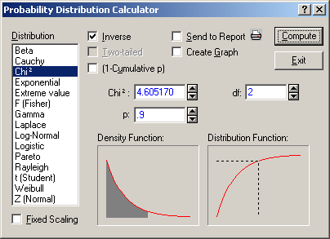
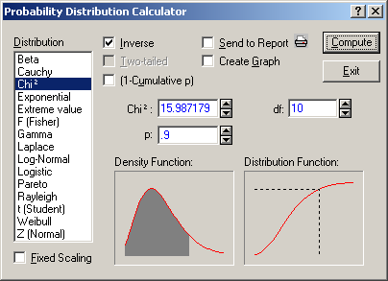
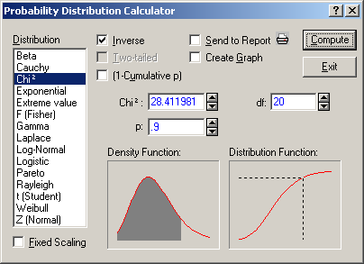

Notes:
Compare to Figure 7.14 Chi-square PDF for various degrees of freedom
The key results are the values of the different Chi-square distributions that capture 90% of the area under the curve:
df = 2, Chi^2 = 4.61
df = 10, Chi^2 = 15.99
df = 20, Chi^2 = 28.41
df = 50, Chi^2 = 63.17
We will use these in hypothesis tests that involve the Chi-square distribution.

Slide 41
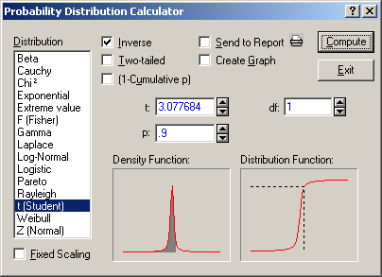
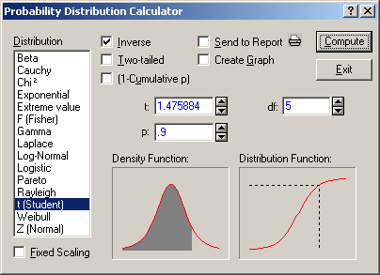


Notes:
Compare to Figure 7.15 t PDF for various degrees of freedom
The key results are the values of the different t distributions that capture 90% of the area under the curve:
df = 1, t = 3.08
df = 5, t = 1.48
df = 20, t = 1.33
df = 50, t = 1.30
We will use these in hypothesis tests that involve the t distribution.

Slide 42




Notes:
Compare to Figure 7.14 F PDF for various degrees of freedom
The key results are the values of the different F distributions that capture 90% of the area under the curve:
df1 & df2 = 2, F = 9.00
df1 & df2 = 10, F = 2.32
df1 & df2 = 20, F = 1.79
df1 & df2 = 40, F = 1.51
We will use these in hypothesis tests that involve the F distribution.

Slide 43


Central Limit Theorem
⇒
D = Any Distribution
N = Normal Distribution
Notes:
In random sampling from a arbitrary population with mean μ and standard deviation σ, the distribution of X-bar when n is large is approximately normal, with mean μ and standard deviation σ/sqrt(n).
Because of this, you will see “sqrt(n)” appear many times in this class.
Note: the word “central” does not imply convergence to an average value; it means that it is central to the field of statistics.

Slide 44



Sampling Distribution
2.5
Notes:
It is unlikely that we would get a sample mean of 2.5, if in fact the population mean was 3.4.
Therefore, we reject the hypothesis that μ = 3.4.
“Unlikely?” - How unlikely are the results? This is the significance level (α).

Slide 45
Monte Carlo Simulation
Random Variables
Response Distribution
Mean
R1
Simulation
Program
Standard Deviation
R2
R3
Y
The Central Limit Theorem in action!
Notes:
Abstract
Tolerance Design is the science of predicting the variation in system performance caused by variations in component values or the environment. This article shows how Monte Carlo simulation can be applied to predict and improve the quality of a system before even one prototype has been built. Using these methods allows new products to be developed rapidly and introduced with fewer unexpected problems. The case study in this article is a simple analog circuit. The analytical methods and optimization process may be successfully applied to any engineering problem where a transfer function can be derived.

Slide 46


Practical Application
Measurement System Criteria
Notes:
MS = Measurement System
We usually rely on 1 reading from a measurement system to estimate our input or output variable values.
An easy way to reduce measurement system error is to average 2 or more readings.

Slide 47

Normal Distribution
99.99
93.8
106.2
Notes:
Most widely used distribution in Statistics, because it fits data for many natural phenomenon: physical, mechanical, electrical, chemical, etc. It also inspired the title of the controversial – and fatally flawed – book The Bell Curve.
Here are just a few applications:
Capacity variation of electrical condensers
Tensile strength of aluminum alloy sheet
Monthly temperature variation
Penetration depth of steel specimens
Rivet-head diameters
Electrical power consumption in a given area
Electrical resistance
Gas molecules velocities
Wear
Noise generator output voltage
Wind velocity
Hardness
Chamber pressure from firing ammunition

Slide 48

Probability Density Function (PDF)
μ = Mean
σ = Standard Deviation
Notes:
The normal distribution is defined by its Probability Density Function (PDF). Think of this as the probability of a variable being equal to a specific value. It’s actually more complicated than that, but don’t worry about it.
Warnings:
Symmetric
-∞ < Values < +∞

Slide 49

σ = 1
σ = 2
σ = 3
Notes:
Here are 3 Normal distributions with the same mean (10), but different standard deviations (1, 2 and 3).
If you were producing a part that had a target value of 10, which distribution would you rather have?
For this distribution, if you wanted to outsource it and had to give tolerances to a supplier, where would you set them?

Slide 50
The Normal Distribution
THE
NORMAL
LAW OF ERROR
STANDS OUT IN THE
EXPERIENCE OF MANKIND
AS ONE OF THE BROADEST
GENERALIZATIONS OF NATURAL
PHILOSOPHY  IT SERVES AS THE
GUIDING INSTRUMENT IN RESEARCHES
IN THE PHYSICAL AND SOCIAL SCIENCES AND
IN MEDICINE AGRICULTURE AND ENGINEERING 
IT IS AN INDISPENSABLE TOOL FOR THE ANALYSIS AND THE
INTERPRETATION OF THE BASIC DATA OBTAINED BY OBSERVATION AND EXPERIMENT
Notes:
by W.J. Youden [Amstat News, p. 44]
The Normal distribution is useful for modeling many naturally occurring quantities.
3 conditions:
Most likely value
Symmetrical
More likely near mean than far
Examples:
Portfolio returns
Process performance

Slide 51

Estimation of Parameters
Maximum at
Mean = 3.3267
Std = 0.7968
Notes:
When estimating parameters on any kind, you might hear about “MLEs” or “Maximum Likelihood Estimates”. These represent the combination of parameter estimates that maximize the likelihood function. For the normal distribution, there are 2 parameter estimates – Mean and StDev – so the likelihood function can be represented as a surface that looks like a mountain. And the combination of Mean and StDev that maximizes the likelihood function is the peak of that mountain.

Slide 52



Measures of Central Tendency
Sum/n
Notes:
Sample of 15 of the 40 battery life data values.
Mean (a.k.a. Average): Sum of Observations/Number of Observations
= 3.33
Median: Middle number: 50th Percentile (If even number of observations, take average of two middle values)
= 3.40
Mode: Most common value (if a tie occurs, Excel picks the lowest; Statistica doesn’t report anything)
= 3.10

Slide 53

Measures of Variability
Min
Max
Sum/(n - 1)
sqrt(Variance)
Max - Min
Notes:
The same sample of 15 of the 40 battery life data values.
Variance: sum[(Value - Mean)²]/(n - 1)
= 0.63
Standard Deviation: Square Root of Variance
= 0.80
Range: Maximum Value - Minimum Value
= 3.10
Why do we use Standard Deviation instead of Variance? Units!

Slide 54

Notes:
Statistica Analysis
Statistics > Basic Statistics/Tables > Descriptive Statistics

Slide 55
Statistica Results
Notes:
Mean = 3.33
Median = 3.40
Mode = “Multiple” and “Frequency of Mode” is blank, because there are two values (3.1 and 3.4) that occur twice in the sample.
Variance = 0.63
Std. Dev. = 0.80
Range = 3.10

Slide 56


Example: Battery Life Data
Notes:
40 observations of battery lives (years)
Mean μ = 3.4 years
Standard Deviation σ = 0.7 years

Slide 57


Notes:
Probability Density Function Plot for mean = 3.4 years and standard deviation = 0.7 years.

Slide 58

Cumulative Distribution Function (CDF)
Notes:
For a continuous random variable, the probability that it is exactly equal to a specific value is infinitesimal.
It’s easier to find the probability that it is less than or equal to a specific value.
CDF = Probability that a random variable (X) is less than or equal to a specific value (x), i.e., the area under the PDF curve to the left of the value.

Slide 59


Notes:
Here is the CDF plot for the battery life data distribution.
The value of the integral from 0 to X is plotted for all values of X in the range from 1 to 6 – well almost.

Slide 60

Normal PDF and CDF
Notes:
The main point is that sometimes it is difficult to work with the PDF, so we work with the CDF.
Also, there are times we want to know the values from the CDF to answer questions, so you should know its relationship to the PDF.

Slide 61



Example
PDF
Area = 0.284
CDF
0.284
Notes:
For the Battery Life data:
Mean μ = 3.4
Standard Deviation σ = 0.7
The warranty period is 3 years, i.e.,
x = 3
Estimate of the proportion of batteries failing during the warranty period
P(X < 3) = ?

Slide 62

Z-Transform
Original Data
μ = 3.4
σ = 0.7
Z-Transform
Z = ?
Standardized Data
μ = 0
σ = 1
Notes:
But we don’t know calculus! What do we do now? Z-Transform.
General form: Z = (X - μ)/σ.
This transform produces a value from a normal distribution with μ=0 and σ=1.
The value indicates how far the number is from the mean in units of standard deviations.
For example, if Z = 2, that would say that the number in question is 2 standard deviations away from the mean.
By using this method, we can calculate the CDF based on μ and σ.
The task is to determine the area under the normal PDF curve that is to the left of 3.
Do this by calculating Z-Transform:
Z = (x - μ)/σ = (3.0 - 3.4)/0.7 = -0.571
Can now calculate the area below 3 using the standard normal CDF.

Slide 63

Notes:
This is the plot of the Standard Normal Cumulative Distribution Function, i.e., N(0, 1).
The values are what you find in most/all statistics textbooks.
Variation is everywhere, even in statistics textbooks; they often report different values for the Standard Normal CDF.
This can be a cause of confusion for statistics students and also a cause for mistakes when doing homework or tests – yet another reason not to like statistics.

Slide 64



Z-Transform
P(X < 3 yr)
P(Z < -0.517)
Notes:
Where do we get the probabilities? I recommend Statistica’s Probability Distribution Calculator:
Statistics > Probability Calculator > Distributions
Distribution = “Z (Normal)”
X: -0.517 (not to be confused with the “X” in formula; enter the value for “Z” in the menu’s field labeled “X”)
mean: 0
st.dev.: 1
Click “Compute”
Returning to the battery life example, the fraction failing less than or equal to 3 years can be determined by using the following:
P(X< 3) = P(Z < -0.571) = 0.284
You don’t need to use the Standard Normal distribution (μ = 0, σ = 1); you can use the battery life data distribution directly (μ = 3.4, σ = 0.7). You should be familiar with the Standard from of the Normal distribution, however, because it is used in many other places in this class.

